Slide 1
CheersPOS Data Transfer
Victor Ramos

Slide 2
Problem Review
Transferring store inventory data from one point of sale to another is currently done manually with Excel
Currently there is no easy way to iterate through a store's inventory data files

Slide 3
Updated Goals
Provide an easy to use transfer tool that iterates through a store's inventory files and gets all the items data​
Store and organize the store's inventory data in a database​
Build tool as a web application to allow implementation into new point of sale​
Have a main database that grows when new stores are added with new items
Tool that allows for the creation of a new store adding items from the Item Library database
Removed Store Login capability as this is more of a POS provider tool

Slide 4
Problems
Different Points of Sales use different UPC types: EAN-13, EAN-8,UPC-A, etc
Couldn’t use UPC API because of this problem. Most UPC API sites also do not keep track of liquor items
Added the ability for the item to have different UPC types

Slide 5
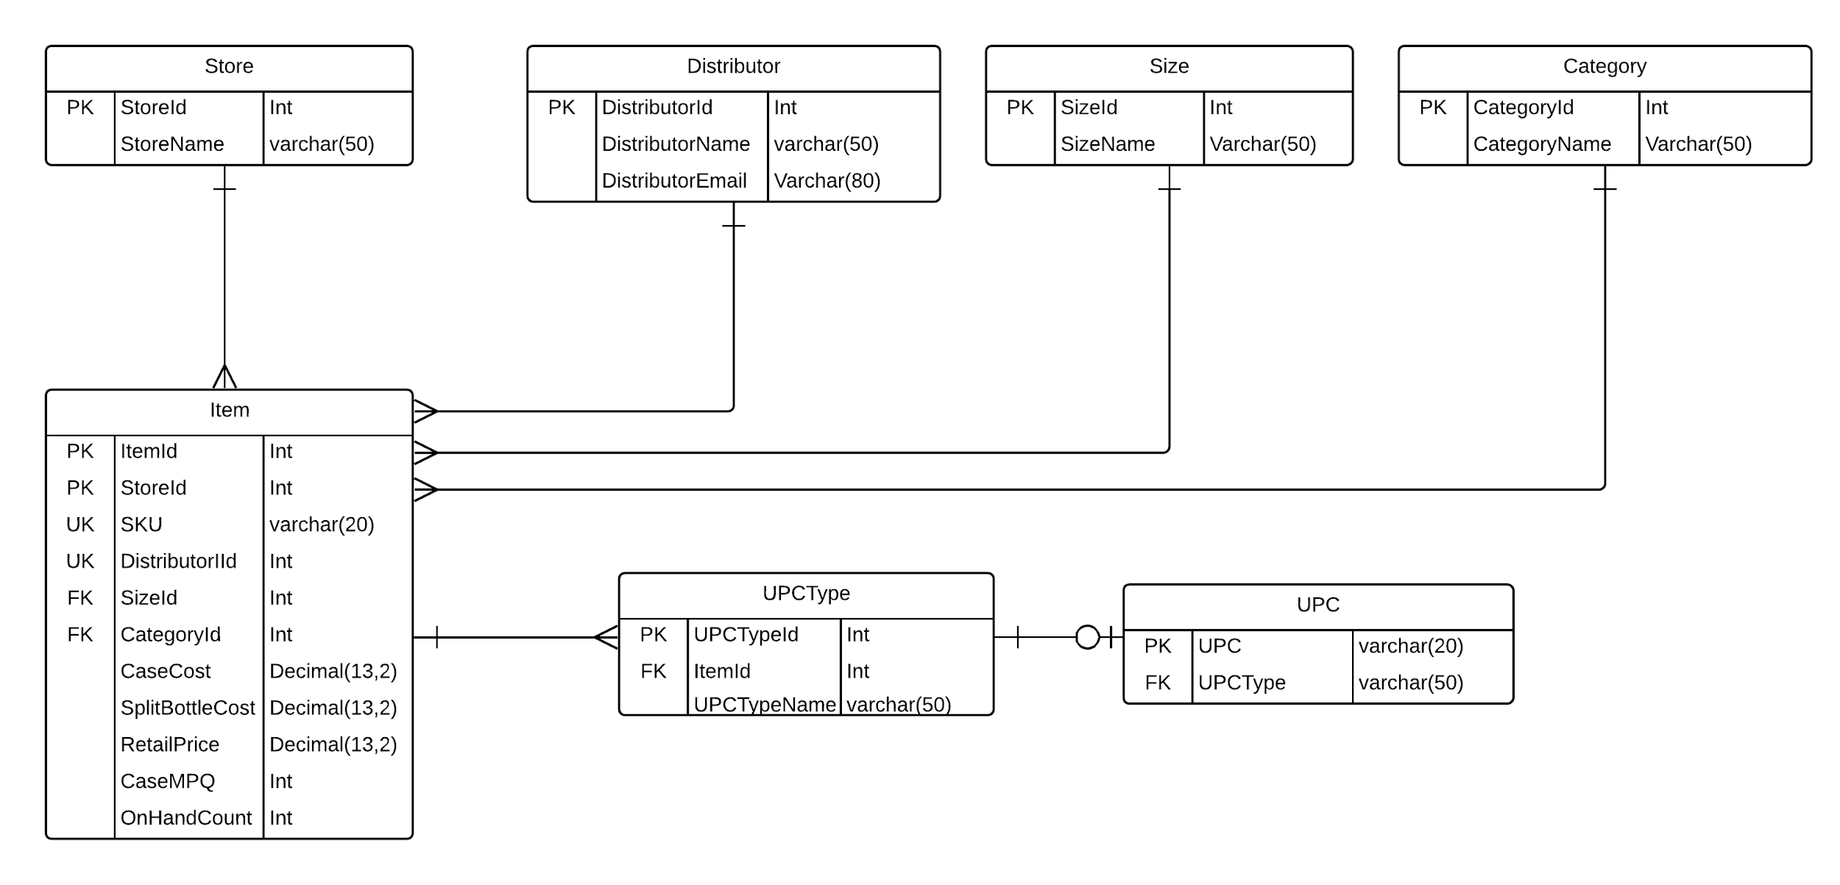
Updated Database Design

Slide 6







Tools

Slide 7
Completed Development
Found all required data from EZFORU store file
Found all required data from EZ Spirits store file, using a dbf library to read store information
Virtual Environment is setup, models for Django are created

Slide 8
Development Schedule
November 4-9: Finish Data Transfer from Store File creating the store in the database
November 10-16: Implement store creator feature
November 17-23: Bug fixing, styling, pdf/csv exporting
November 24-30: Transfer file to Amazon Lambda and set database from MySql to Amazon Aurora
December 1-7: Finish up. If time implement ability to insert Pricebook files
December 8-14: Present

Slide 9
Questions?

